Slide 1
Shiny Workshop Day 2
August 28, 2019
TEA Analytics

Slide 2
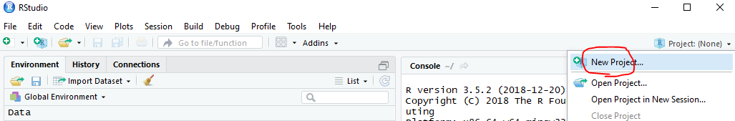
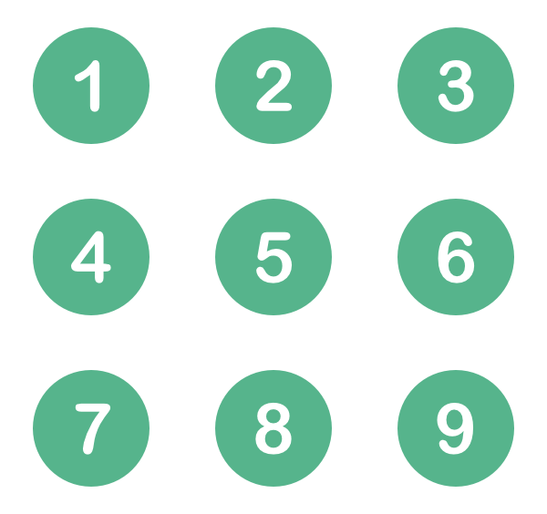
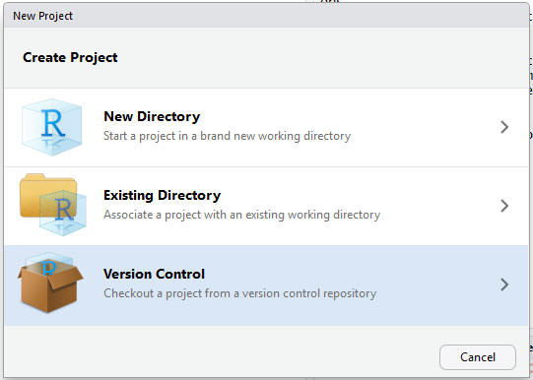
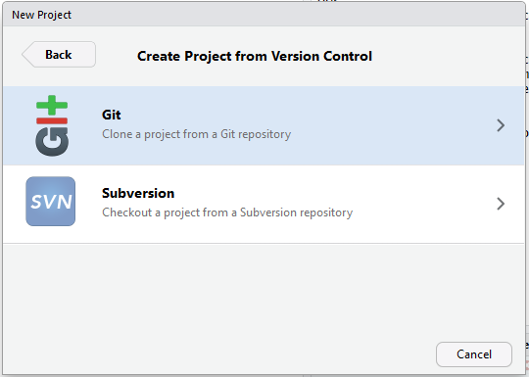
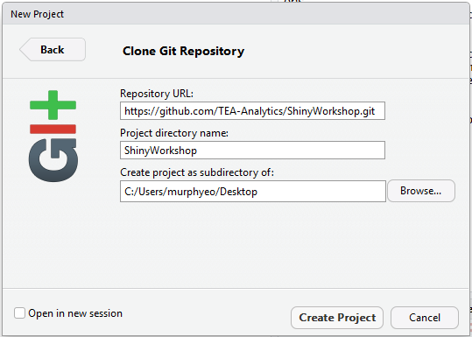
Lunch Time To-Do List
Make sure that you are a member of github/TEA-Analytics.
Create a new project “ShinyWorkshop” by cloning the repo.

Slide 3
TEA Shiny Server & Deployment

Slide 4
Shiny Server
It’s a web server that makes shiny apps available over the web.
PROD server
https://analyze.teainc.org
Apps are accessible from anywhere
Staging server
http://rshinydev001:3838/
Apps are available only within TEA network.
FYI:
Operating System: Linux (Ubuntu)
System Analyst: Brandon Clayton
URL is case sensitive.

Slide 5
Deployment Steps
Dev
Develop an app locally.
Staging
Place the app folder in Staging location: \\analystfs\westcoastdata\Shiny\Staging
Check your app on http://rshinydev001:3838/
If debugging is needed, do so here: http://rshinydev001:8787/
Decide on the configurations (including user group) and let Brandon know. Submit a ticket.
PROD
Once all working, place the folder here: \\analystfs\westcoastdata\Shiny\Prod
Check your app on https://analyze.teainc.org/
Debug if necessary: http://rshiny001:8787
Notify Brandon and app users.

Slide 6
Demo
Deployment to Staging
Exercises/Solutions/App1.02_reactive

Slide 7
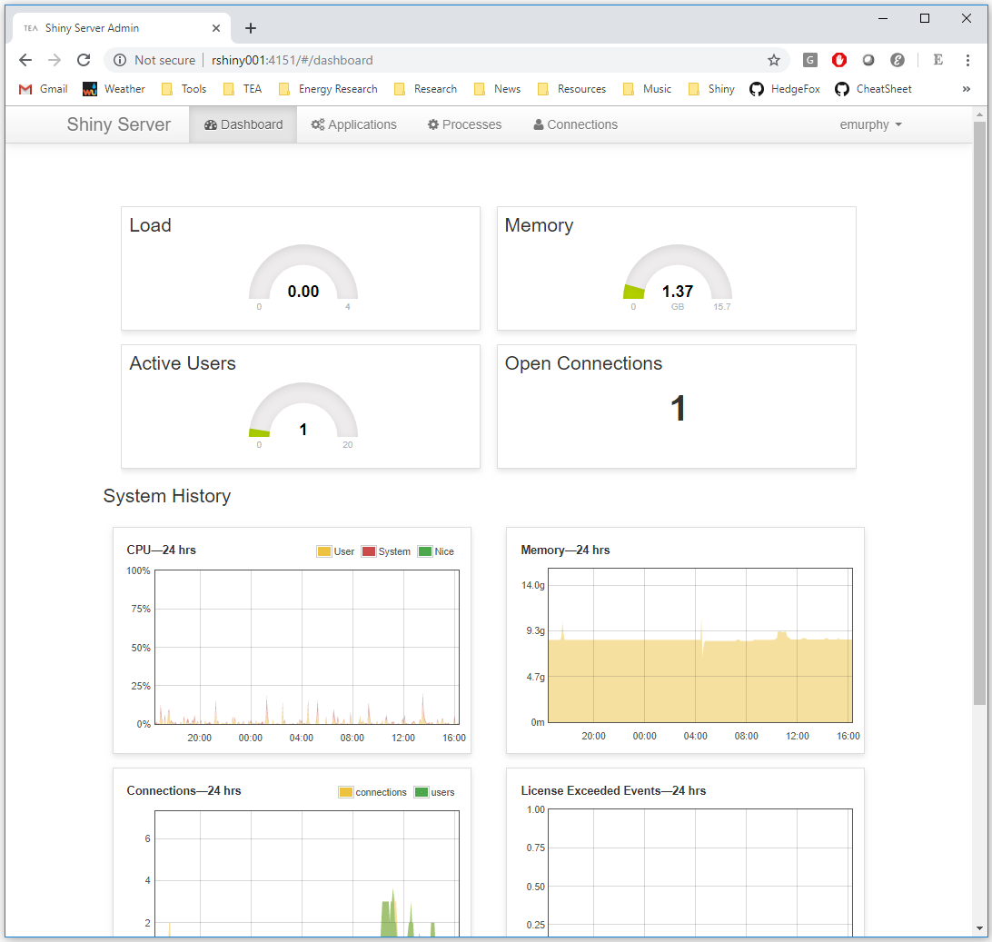
Admin Page
PROD: http://rshiny001:4151/
Staging: http://rshinydev001:4151/
Currently only admin users have access.
You can:
Check memory & CPU usages
Look at app access histories
Kill instances

Slide 8
App Configurations/Security
User Groups (Active Directory)
Default: All analysts, IT admin (Brandon)
Permission levels are set per group.
One person can be in multiple groups.
External clients need a ‘teainc.org’ email, and each company should form a group.
Timeout
Default: 30 min
Range: 1 sec ~ indefinite.
Subfolders
If there are subfolder structures within the main folder, you can set different configurations per subfolder.

Slide 9
Accessing Network Files
Certain network locations are visible from Shiny Server (via mounting).
\\Analystfs\westcoastdata → /mnt/analystfs/westcoastdata
\\seaanalystfs1\Data → /mnt/seaanalyst1/data
\\seafs1\Data → /mnt/seafs1/Data
Note: Working directory is always the shiny app folder.
Watch out if you have a path to a file in the network.
When you deploy dev app to staging, make sure to change the path name.

Slide 10
Session
Optional argument in server function.
Included in the TEABranded template.
Needed when
Accessing user info
session$user
session$groups
session$clientData$url_search
Update*Input
Using module

Slide 11
External Client Access
Questions to ask before giving access:
Can we do without giving access?
We are service providers, not app provider.
Do you have to limit the access?
Are there any sensitive data, tabs or sections to hide?
Pre-set user inputs.
Is it vulnerable to misinterpretation?
Disclaimer and signature page.
Who’s in charge for customer support?
Error handling
Show only meaningful messages.
Support plans
When it fails, what’s the procedure for support?

Slide 12
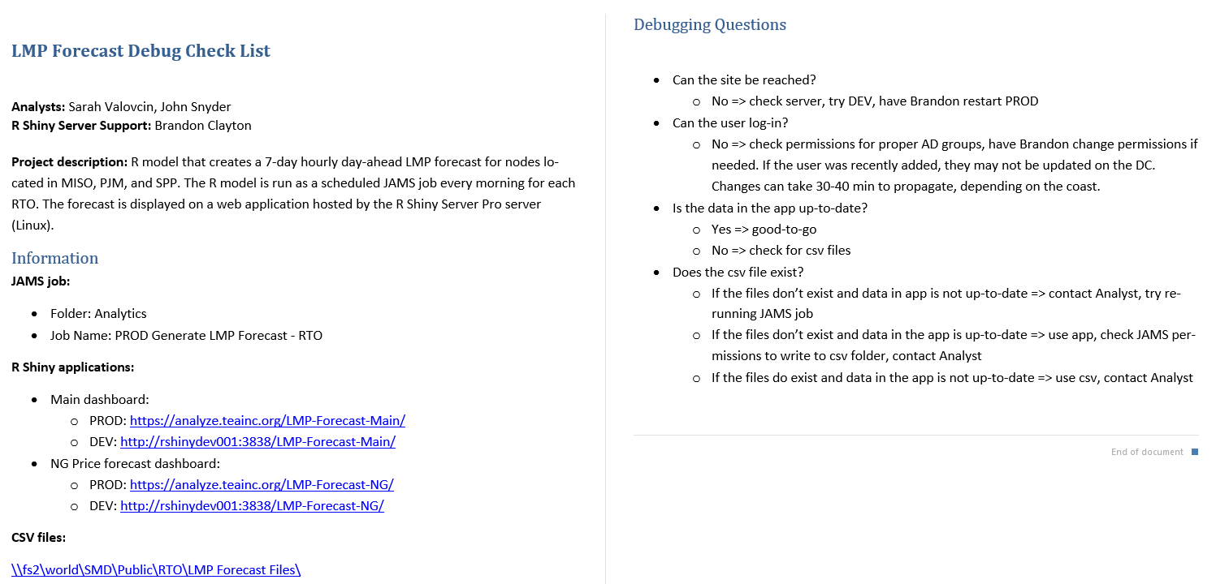
Support Plans
Talk with Brandon for developing a support plan.
Example:

Slide 13
Known Issues

Slide 14
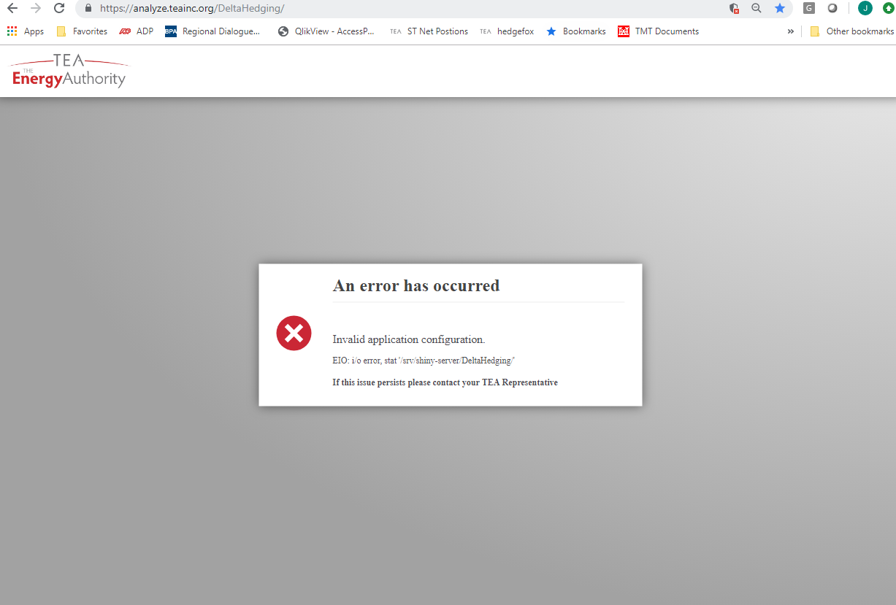
Error at Opening

Slide 15
Error at Opening
At opening, you may encounter an error which goes away by refreshing the page a few times.
Cause: The linux machine need to look into the remote \\analystfs network location for the app files. There seems to be a glitch somewhere.
Potential solution:
If we don’t mind using putty for placing the files directly in the linux server, the error should go away.

Slide 16

Version Management
We all share the same Shiny Servers.
We share the same R version and package versions on the server regardless of what you use locally.
Current R on Servers: Version 3.4.4 (2018-03-15) -- "Someone to Lean On”
We plan to update it on Feb 2020.
When you need to update a package for some reason, ask the entire group and have everyone test it on Staging before updating it on PROD.
E.g. rhandsontable & dygraph
Known versioning issue:
Rds files in R version 3.5 or higher is not readable in R version 3.4 or earlier. Specify version in saveRDS().
Potential Solution: Look into ‘packrat’ or ‘renv.’
Consensus on a version to install.
Update Staging server.
Everyone check apps.
Update PROD.
Everyone check apps.

Slide 17
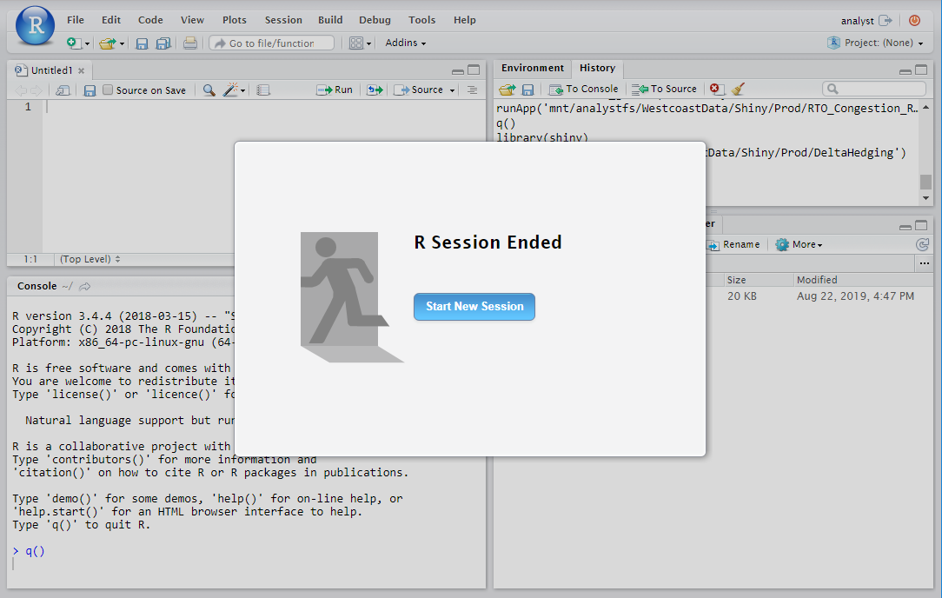
One R Studio Account to Share
We currently use an open source R Studio Server on the Shiny Server with one shared account.
It’s set up so that we can debug apps in the same linux environment.
With the current settings, you may kick someone out when you login. Be aware. And please, please quit and close everything when you are done.
When this becomes an issue, we’ll discuss purchasing a license for Pro Studio Server.
Use slack # r-studio channel with addressing “@here.”
Kick out someone from Rstudio server.
Version update questions
…
Close scripts
Optionally you can delete your history. I recommend not clearing the entire history.
Run q()

Slide 18


Concurrent Usages
Single thread computation:
Per App.
Not Per User.
Not Per Instance.
Con: User A’s computation could pause B and C’s app instances.
Pro: Data loaded and cached when A opened the app could be utilized by B and C (depending on how you set it). → We’ll discuss this later.
Potential Solutions
Futures & promises.
Set up multiple apps using subfolders.
Load testing + set limit for number of concurrent users.
C
B
A

Slide 19
Database Connections

Slide 20
Database connections
Dev (Local)
No need to specify username/password in connection string. (Windows authentication used).
A use of generic credentials is not recommended.
"Driver={SQL Server}; Server=SQLUAnalytics; Database=Ozette;“
Shiny servers (PROD or Staging)
Need to specify username/password. (Ask DBA for a generic account).
Option 1: "Driver={ODBC Driver 17 for SQL Server}; Server=SQLPAnalytics; Database=Ozette; Uid=shinyuser; pwd=xxxxxxx;”
Can be used with ‘RODBC’ or ‘odbc’
Need to be updated when driver is updated.
Option 2: "Driver={SQLServer}; Server=SQLPAnalytics; Database=Ozette; Uid=shinyuser; pwd=xxxxxxx;”
Can be used with ‘odbc’
Notice no space between SQL and Server.
No need to update when a driver is updated.

Slide 21
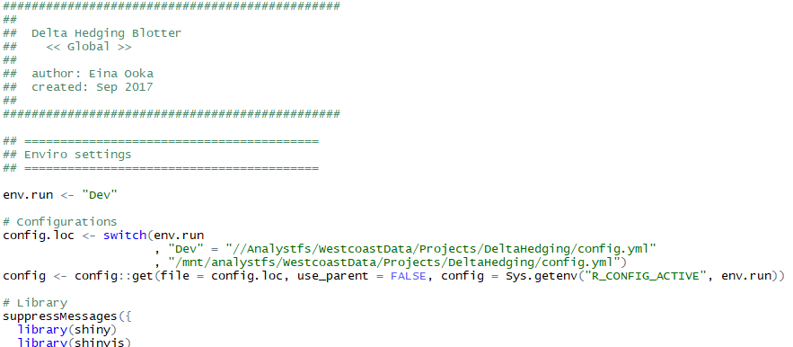
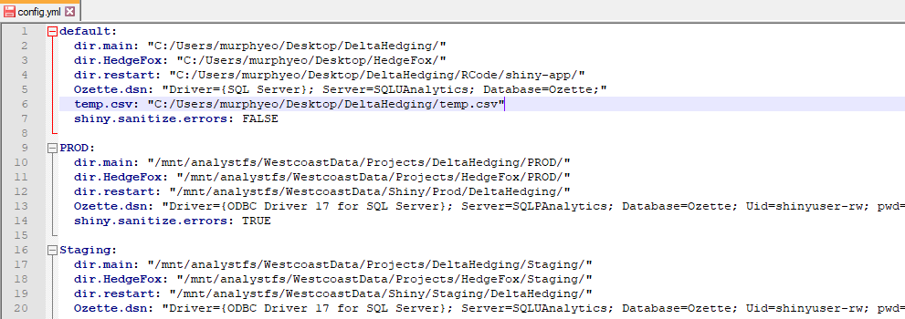
Managing Deployment
During deployment, you need to change:
Network folder locations
Database connection string
Error display options
A solution: use config.

Slide 22
Config for credential management
Benefit of ‘config’ package
One file for all credentials.
When a password changes, you have one place to update it.
Deployment is easier.
Location for a config file
One location in the network (untracked via git).
In the app folder. (You can track it or not.)
Manage parallel environments
PROD app ↔ PROD database server
Staging app ↔ UAT database server
Local (dev) app ↔ Database

Slide 23
When to load data?
In global.r
Loaded once when a thread opens, shared between multiple “concurrent” users.
Inconsistent load times, all at the beginning, before UI shows up.
Within server (script)
Loaded once every time an instance opens.
Same load time for everyone every time, all at the beginning, after UI shows up.
Within reactive
Loaded multiple times within a session if needed.
It may never load the data if not needed.
Using reactiveValues
You decide when it’s loaded.
Useful for partial load + appending.
Users likes to know if it’s loading or broken.
Users like expected behaviors.
Users prefer initial load time than intermittent pauses.

Slide 24
Controlling global data load
Data loaded within global.r linger for a while after all instances close.
Data updates or code changes may not be immediately reflected on the app.
When you want to force rerun of glabal.r, use restart.txt.

Slide 25
Apps Out There

Slide 26

Advanced Apps
RStudio Shiny Gallery
https://shiny.rstudio.com/gallery/
Htmlwidget Gallery
http://gallery.htmlwidgets.org/
Rstudio Shiny User Showcase
https://www.rstudio.com/products/shiny/shiny-user-showcase/
Shiny Contest Winners
https://blog.rstudio.com/2019/04/05/first-shiny-contest-winners/

Slide 27
Git & GitHub

Slide 28


Git & GitHub
Git is a distributed version control system that runs on your local machine. It keeps track of your files and modifications.
https://git-scm.com/
GitHub is a website that allows you to publish your Git repositories online and collaborate with other people.
https://github.com/
We have a private account that is not open to public.

Slide 29
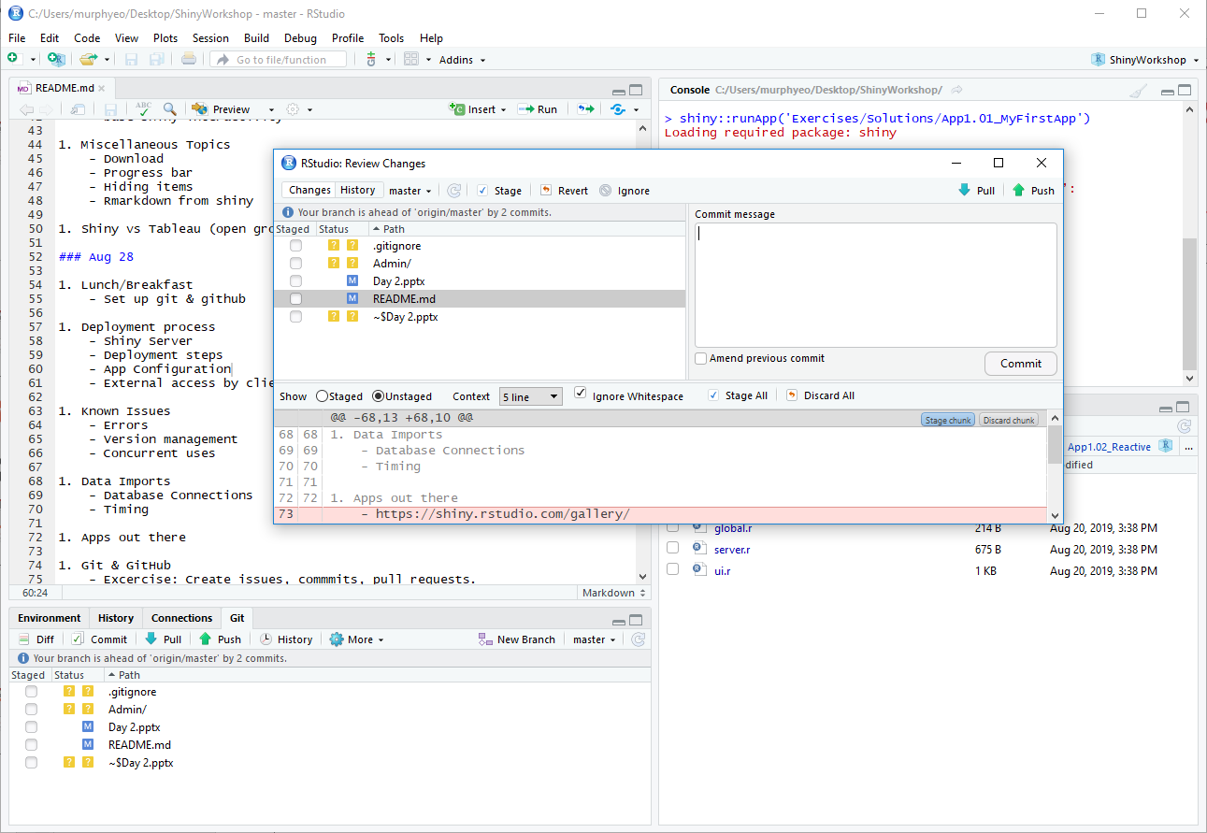
Git & GitHub integration in RStudio

Slide 30
Demo
GitHub functionalities
Branches/Network
Issues
References from commit messages.
Projects
Changes in RStudio
Commit & Push

Slide 31
Exercise
Create a new branch in ShinyWorkshop repo.
Pull this repo to your local machine.
Activate your branch.
Edit, save, stage, commit. Make sure to mention the issue number.
Push to remote repo.

Slide 32
Demo
Merge.

Slide 33
Deployment Steps with optional source control steps
Dev
Develop an app locally.
Staging
Place the app folder in Staging location: \\analystfs\westcoastdata\Shiny\Staging
Check your app on http://rshinydev001:3838/
If debugging is needed, do so here: http://rshinydev001:8787/
Decide on the configurations (including user group) and let Brandon know. Submit a ticket.
PROD
Once all working, place the folder here: \\analystfs\westcoastdata\Shiny\Prod
Check your app on https://analyze.teainc.org/
Debug if necessary: http://rshiny001:8787
Notify Brandon and app users.
Track code changes in github.
Push local changes to remote staging branch.
Have users check the app.
Merge staging branch into master.
Release with a version number.

Slide 34
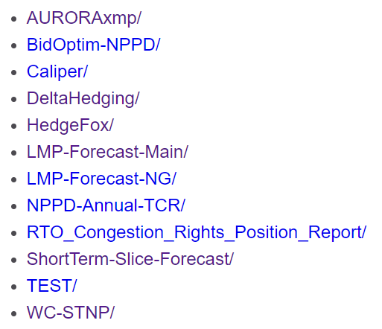
Naming Apps
What is it?
What does it do?
What do you want to get out?
A symbol that captures the concept?

Slide 35
Debugging

Slide 36
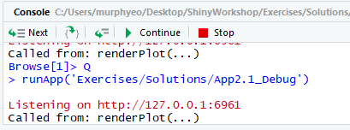
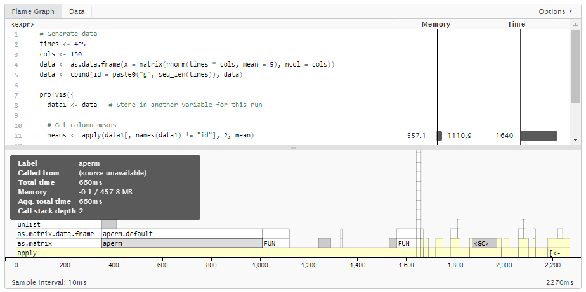
Debugging
Debug
Breakpoints
Pros: No change in your code.
Cons: works only within server.
Browser()
Pros: Like debugger but works everywhere.
Cons: Changes in your code.
Print()
Add messages that are printed to the console.
Pros: You can keep it in the code for PROD.
Showcase Mode
https://shiny.rstudio.com/gallery/kmeans-example.html
runApp(…, display.mode = "showcase“)
shiny.reactlog
Detailed look at shiny reactivity.
Performance Optimization
Profvis
Find which calculation is taking time.
https://rstudio.github.io/profvis/
Activate “debugger” where you can look around while everything is suspended as is.

Slide 37
Exercise 2-01
Open Exercises/Solutions/App1.06_Validate.
Figure out why this error flashes when market is changed from SPP to CAISO:
Find a solution for getting rid of it.
Use:
Browser()
Validate(need())

Slide 38


Error Handling
Base R
tryCatch(…, error=function(e){…})
Shiny
Validate(need(…, message = “”))
options(shiny.sanitize.errors = TRUE)
safeError() for controlled error messages.
Uncontrolled R’s native error message:
It may not make sense to users. It might be revealing of sensitive information.
Controlled safe message:
Messages are more meaningful.
Uncontrolled with error-sanitizer:

Slide 39
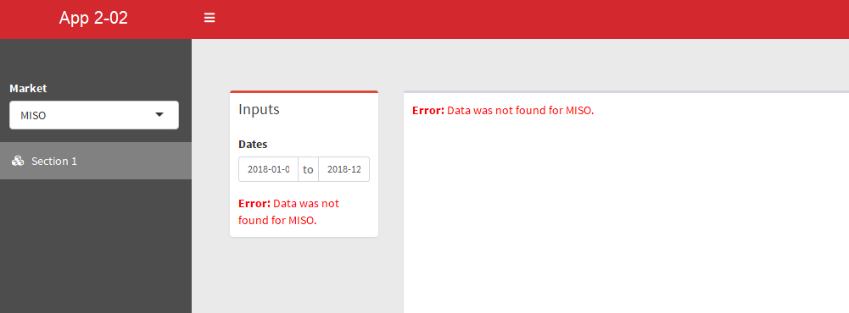
Exercise 2-02
Show a safe error message while error-sanitizer on.

Slide 40
Exercise 2-02
Get rid of validate() for data imports. (Line 12 in server.r)
Set shiny.sanitize.errors = TRUE and run the app. Check the error message.
Add safe error.
Run it again and check the error message.
Use:
options(shiny.sanitize.errors = TRUE)
If(…) stop(safeError(…))

Slide 41
Advanced Topics
Use of Module

Slide 42
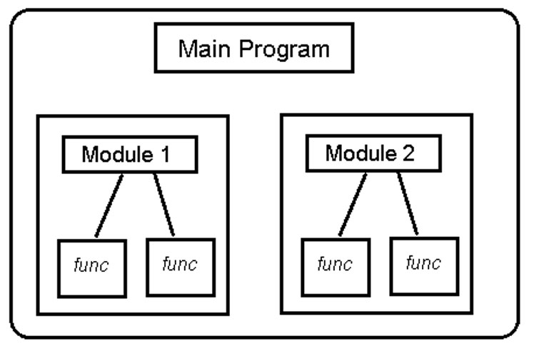
software design technique
Fact: As we develop more shiny apps, we get closer to web programmers. Adopt some of their techniques to start with.
We already talked about separation of Dev/Staging/PROD environments.
Modular programming is a software design technique that emphasizes separating the functionality of a program into independent, interchangeable modules, such that each contains everything necessary to execute only one aspect of the desired functionality.

Slide 43
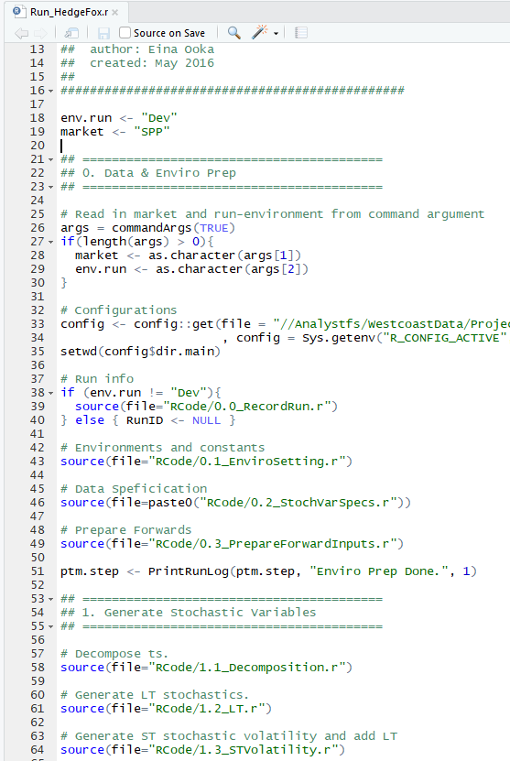
Modularization for Shiny
In R
Functions
If you repeat yourself 3 times, write a function
Or once for modularization.
Source
Technically not modular(?). But a technique to break up a program.
In Shiny
Functions
Module
Originally introduced for reducing repetitions, but more and more people are using it to break the app into modular pieces.
Bad Example: HedgeFox app
https://analyze.teainc.org/HedgeFox/PNW/
https://github.com/TEA-Analytics/HedgeFox/blob/master/RCode/shiny-app/Common/server.r#L804

Slide 44
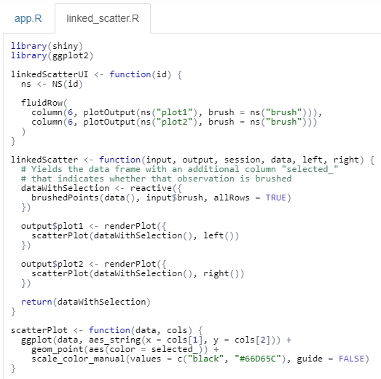
Module Structure
Recommended structure includes a set of
a ui function
a server function
within a file named accordingly.
The server function is a simple subset of the main server function.
Optionally, you can return (reactive) objects.
The ui function wraps ids with a namespace.
Source: http://shiny.rstudio.com/gallery/module-example.html
namespace
Must have
optional

Slide 45
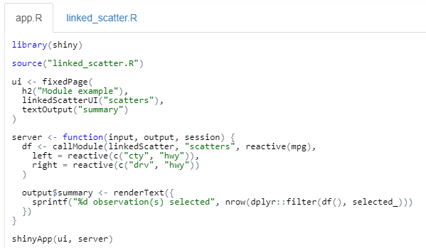
Module Structure
The module ui function
Adds ui objects
Make the user inputs available under the namespace.
The module server function
Is called by callModule, together with a namespace.
All user inputs under the namespace will be available.
Reactive objects (except input$*) need to be added as arguments.
A returned reactive object can be assigned and made available for other sections.
global.r
ui.r
server.r

Slide 46
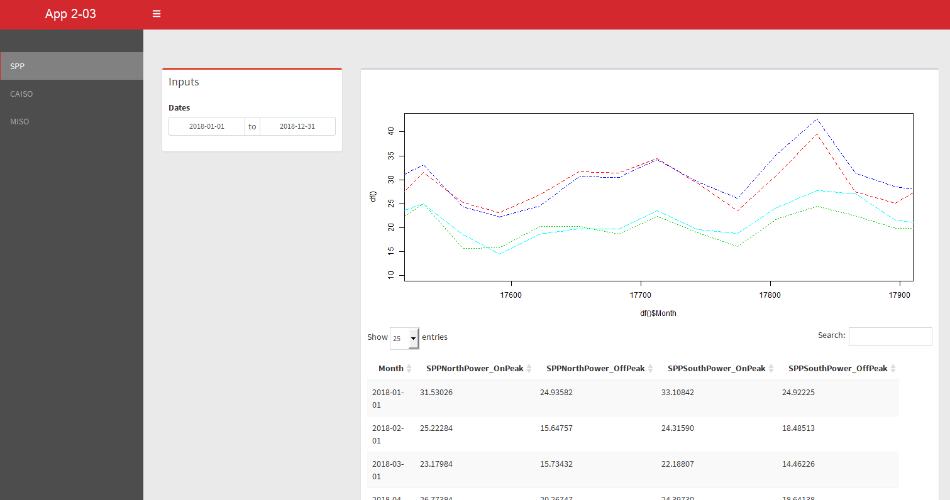
Demo 2-03

Slide 47
Reactive spaghetti vs reactive ravioli
Advantages & Benefits
Modularization
Better overview of a large app
Easy re-use of codes
No name collisions.
Disadvantages
Adds complexity for beginners and intermediate developers.
Debugging can be trickier, until you get used to it.
Tips: use shortcuts: F2 and Ctrl + Shift + F

Slide 48
Advanced Topics
Shiny App as a Package

Slide 49
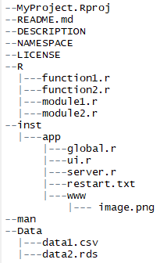
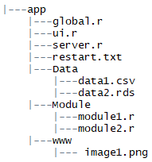
File Organization
There are a group of shiny developers advocating for shiny apps as packages.
Pros
A preset documentation format in DESCRIPTION
Built-in help documentation.
Explicit package dependencies.
Unit testing.
As a Package
Standard
Cons
Easy deployment for shiny.io users but we need to unpack it before deployment.
Look up ‘golem’ for more info.

Slide 50
Advanced Topics
Futures & Promises

Slide 51
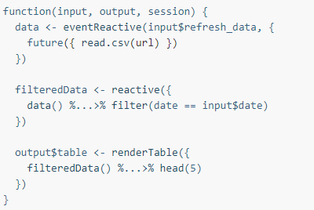
Async programming in R
Future launches async task (invoking) in another thread.
Promise waits for the completion and incorporates the results into the main thread (handling).
Read:
https://rstudio.github.io/promises/articles/futures.html
https://rstudio.github.io/promises/articles/shiny.html
Standard R Operation
Asynchronous Operation
invoking
handling

Slide 52
Steps for Async Programming
Identify slow operations.
Convert the slow operation into a future.
Any code that relies on the result of that operation (if any), now must be converted to promise handlers (%...>%) that operate on the future object.

Slide 53
Shiny vs Tableau

Slide 54
Shiny Pros vs Cons

Slide 55
Q&A

